Slide 1


Sentiment Analysis Using Scraped Reviews
Duy Nguyen, Garrett Shankel, David George
Notes:
David

Slide 2


Scope of Discussion
Scraping
Exploratory Data Analysis (EDA)
Populating Database
Natural Language Processing (NLP) Methods
Generating Outputs
Notes:
David

Slide 3
Goal
Hotels are ranked according to counts of positive and negative feedbacks created by the analyses of scraped reviews stored in a database.
Key factors such as cleanliness, noise level, safety, and the friendliness of the staff can dramatically change the quality of a person's stay.
Factors used to classify a review:
Cleanliness
Staff friendliness
Noise
Hotel lighting
Safety
Comfort
Smell
Notes:
David

Slide 4


Scraping
{
"_id" : ObjectId("62dc9932badf94e0e980a10d"),
"Name" : "Erez0549790011",
"Contributions" : "5",
"Rating" : "45",
"Review" : "Eric Salomon The hotel is old and untidy, the room was very small that it is really hard to have two people, the shower and toilet are very small, we asked to change sheets and it took two days until they did, the room was very old .. we expected that according to the price we paid, we will get something much better",
"DateOfStay" : "Date of stay: July 2022",
"TripType" : "Trip type: Travelled as a couple",
"HotelName" : "InterContinental Paris - Le Grand",
"City" : "There are more places to choose from in the Paris area."
}
Reviews taken from tripadvisor for Hotels in Paris, France.
Python’s library BeautifulSoup was leveraged to scrape 10 html pages of 30 individual hotels each page, and within them 10 html pages of 10 reviews for each page.
Other libraries: requests, pymongo.
MongoDB was used for storage.
Both the title and review text are joined together.
mongoDB Document
Notes:
David

Slide 5
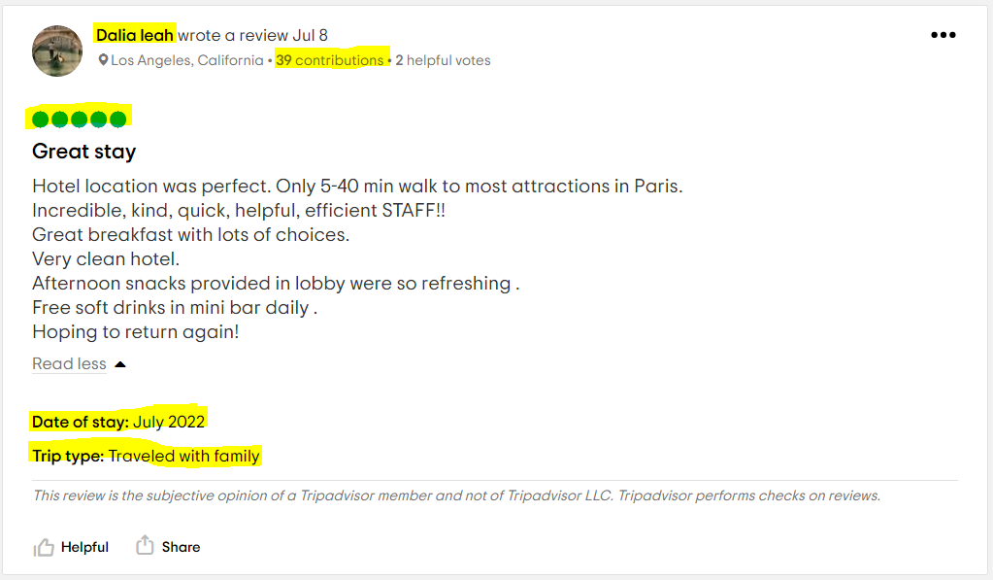
Notes:
Duy
Highlighted here are what we extracted from the html pages, including usernames, number of their review contributions, the rating, the title and body, the date of stay and the trip type. We decided to join the title WITH the review body make the analysis more complete.
Using the processing power of our computers, we managed to scrape and process 14,000 reviews into a mongoDB database in 2.5 hours, which comes down to 1.6 reviews per second.
The first 10 pages of reviews, which can be set as our scraping capacity, seems to only capture reviews from the last 3 months, because tripadvisor sort their reviews by new and there are always 10 per page.

Slide 6
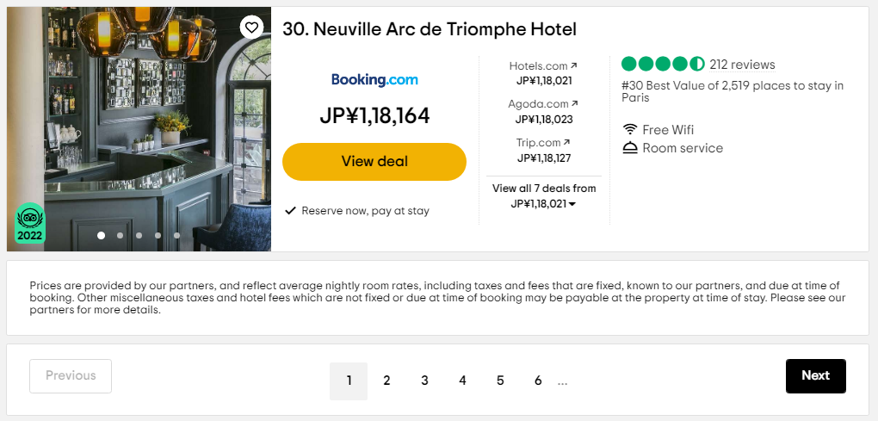
Notes:
Duy
First 10 pages of hotels, with 30 hotels each page, seemed sufficient to capture variety.
So therefore, we have a total of 300 hotels, and 30,000 reviews.
From the 300 hotels in Paris, we only managed to capture ratings of 3.5 and above, and not lower. This can be a con because without a more powerful scraping technology, we cannot capture the full spectrum of sentiments that are based on the voluntary ratings metric alone.

Slide 7

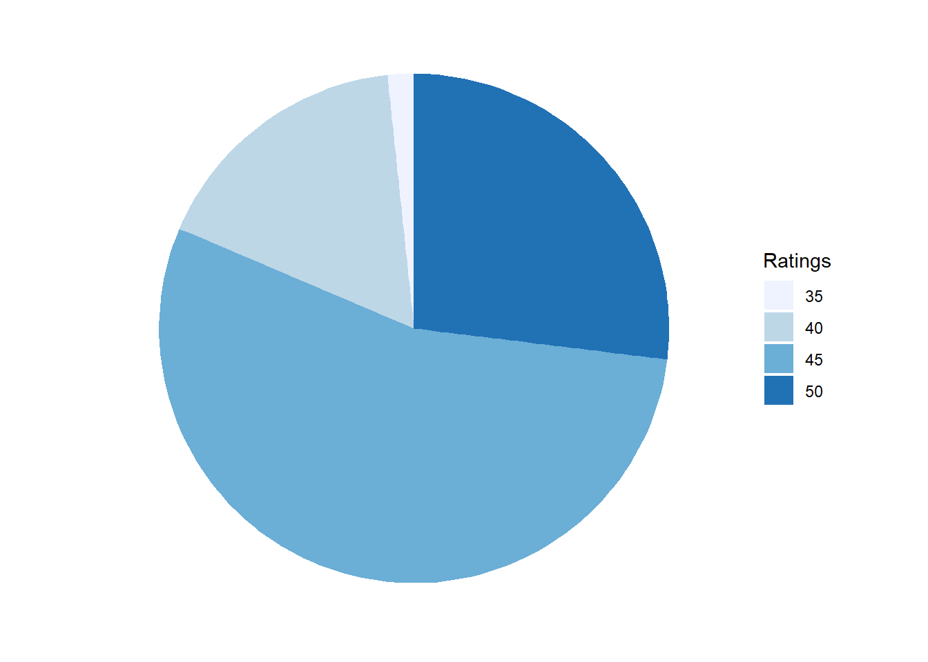
Ratings
Notes:
Duy
From this here graph, we can say that over 50% of people who wanted to write a review needed to say that our 300 hotels are 4.5 and not a perfect 5.0. However, a quarter of reviewers did say 5.0 and about 90% of the rest said 4.0. If I was a high corporate figure and I looked at that small slice of silver, I would say that in the last month there is still a good amount of people that aren’t satisfied with the hotels in Paris and those people should be targeted for special offers or the like, while considering their reviews separately. But, we can still get a strong feeling about the high quality of hotels in Paris by looking at this plot.

Slide 8
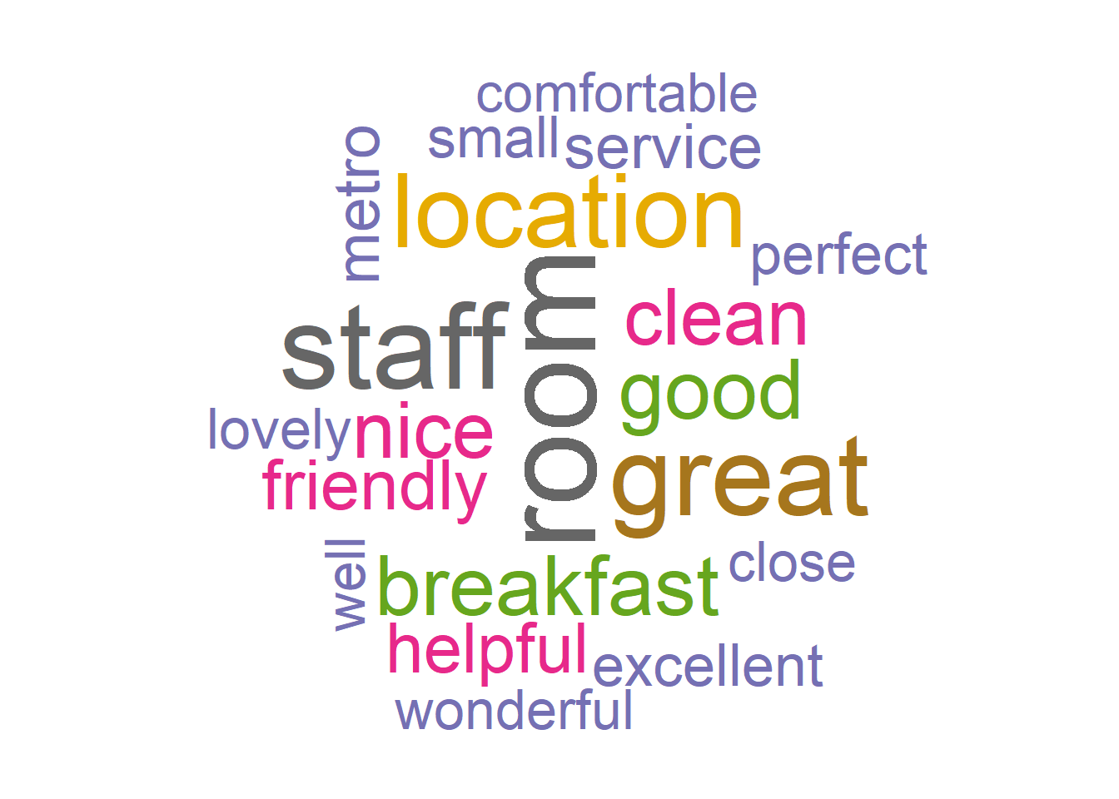
Word Clouds
Notes:
Duy
Without a doubt room and staff were discussed the most by the reviewers. Amongst those two, we can see a decreasing trend in the more important topics like location, clean, and friendly. But, how is this different between types of travellers? I’m talking about couples, families, business trips, etc… We will see that in a second.

Slide 9
Excluded Words
its
an
the
for
that
etc…
airport
terminal
flight
one
two
etc…
Notes:
Duy
Stopwords like its, an, the, for, and that were removed from the equation, along with other words like airport, terminal, and flight, simply because they don’t have much use for NLP and they do not add value to our sentiment analysis.

Slide 10
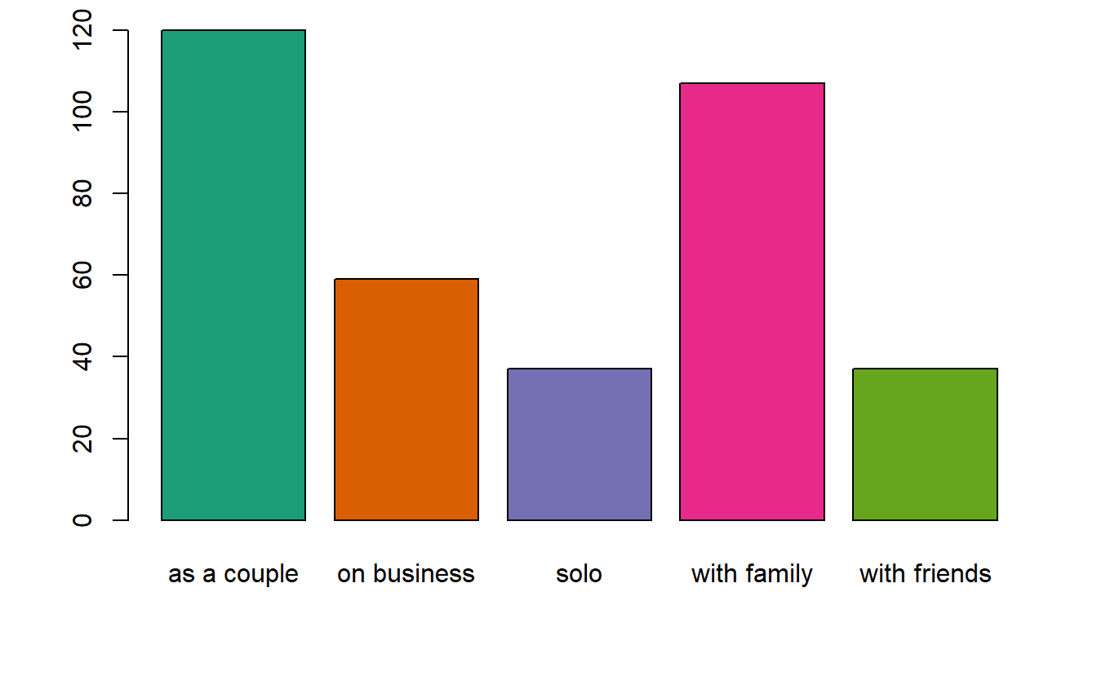
Traveler Types
Notes:
Duy
For a romantic city like Paris, it makes a lot of sense to see couples dominate out of the 5 types of travellers here, which was pulled from the voluntary inputs of reviewers. Apparently, Paris seems to also be very child-friendly. Quite a lot of business trips were made to Paris hotels and were reviewed as well, which is a larger number than people who just wanted to come to Paris for leisure, either solo or with friends.

Slide 11
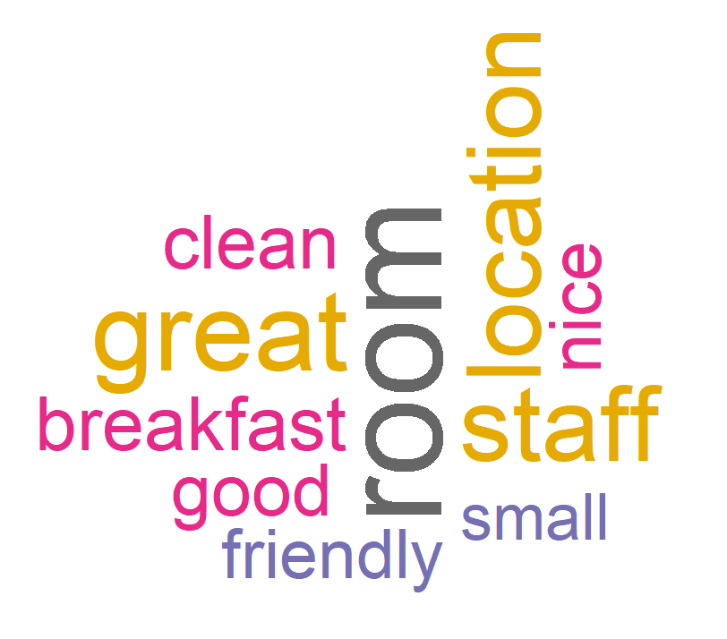
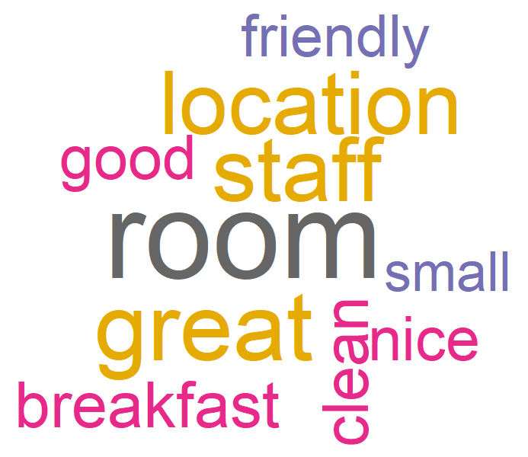
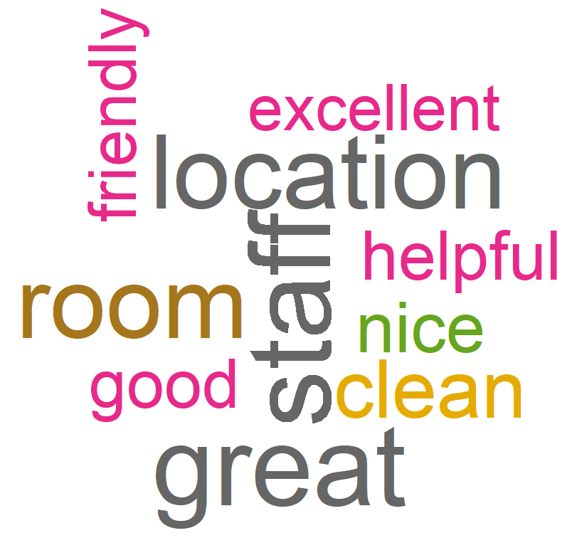
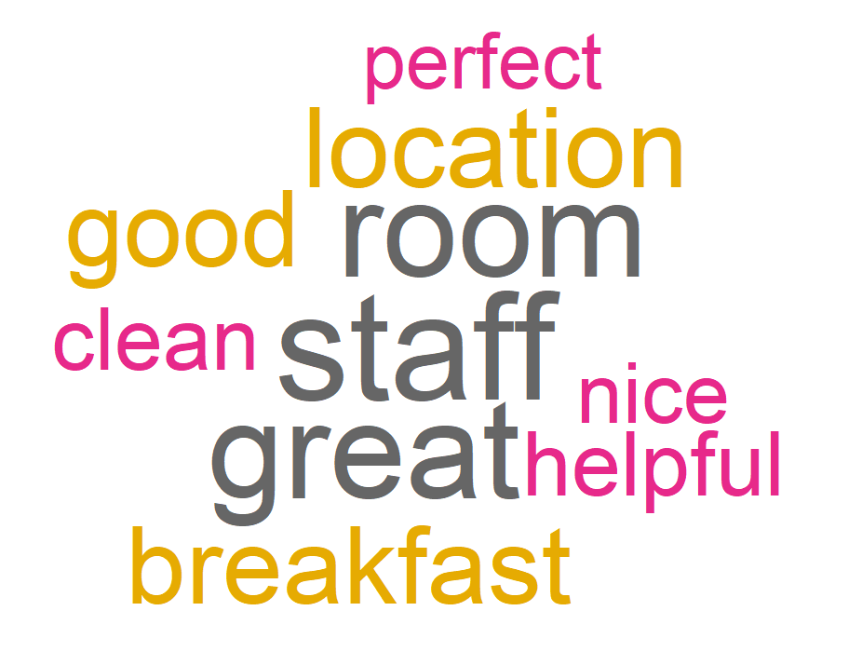
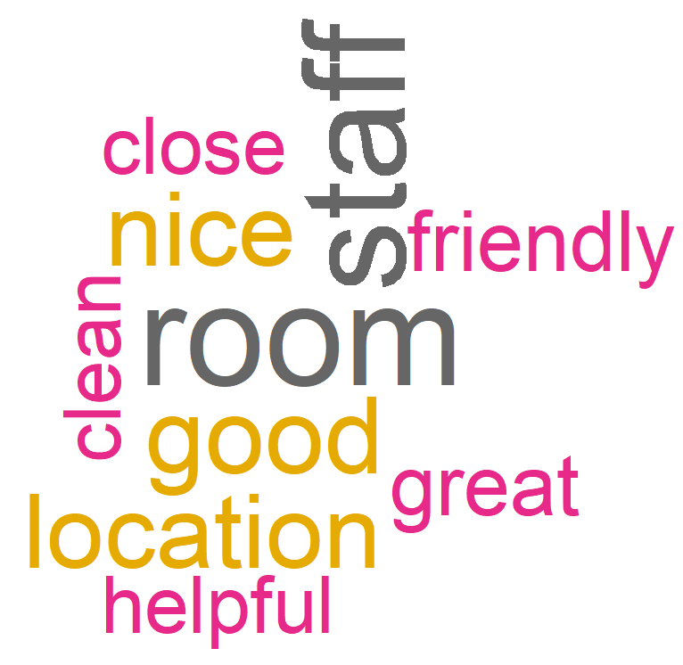
Traveller Types
Word Clouds
Couples
Family
Business
Friends
Solo
Notes:
Duy
Room and staff go hand in hand as the hot topics of all types of travellers, as well as location and breakfast. Something like this dashboard here can be very profitable for corporate as information about one or some types of travellers who most frequent your hotel and topics that they care most about is very valuable.

Slide 12
Natural Language Processing
Valence Aware Dictionary for Sentiment Reasoning (VADER)
from nltk.sentiment.vader import SentimentIntensityAnalyzer
“The room was incredibly dirty”.
Notes:
Duy
Now we will go on with the inner workings of NLP. Our reviews are broken down into their component sentences, which are then classified by the Valence Aware Dictionary for Sentiment Reasoning, or VADER, a model used for text analysis sensitive to both positives and negatives as well as intensity of emotion, available from the NLTK package. Each sentences were then categorized whether or not it contains a keyword, and a list of synonyms and antonyms were generated for those keywords. For example, “The room was incredibly dirty”, this sentence would fall in the “clean” category because dirty is the antonym of clean. This sentence is then passed by VADER as negative.

Slide 13
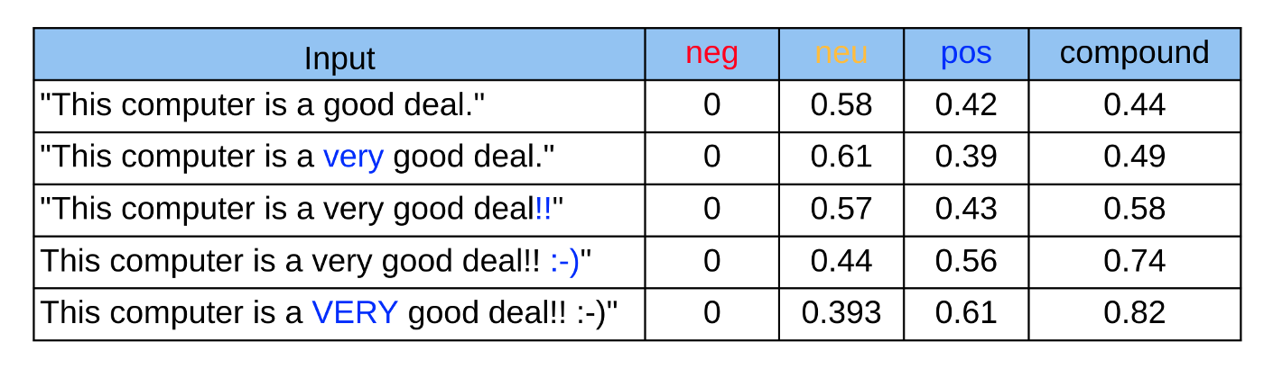
Issues With Vader Package
Vader rates phrases on their “lexical features”
-4 Extremely negative
+4 Extremely positive
Difficulty classifying oddly worded or “passive aggressive” reviews
“This hotel was anything but clean”
Notes:
Garrett - Thank you Duy. As Duy said we originally started with nltk.vader to classify the reviews. We quickly noticed that there were issues with this method of classification. Since Vader rates phrases on their “lexical features” i.e. values are assigned to individual words or small phrases, there were a number of instances where vader would classify phrases incorrectly because it was not looking at the sentence as a whole. Especially when the meaning was confusing or where the review was passive aggressive. For example, “This hotel was anything but clean” could easily be classified incorrectly.

Slide 14
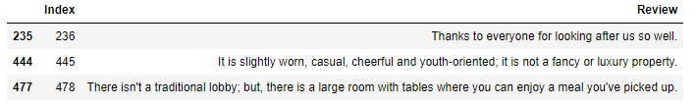
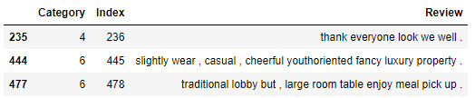
ELMo to Address Sentence Context
First models were built using LSTM (Long-Short term memory)
Original LSTM models could only produce an accuracy of 26%
ELMo or Embeddings from Language Models
NLP framework using LSTM
Built by AllenNLP
Validation in ELMo had a 72% accuracy.
Notes:
In order to address this problem we sought out other methods that performed better with context. One candidate was LSTM or long short term memory. This proved promising, but we needed a large dataset in order to train the neural networks. Since the classifications that we were using for the data were custom we couldn’t go out on the web and grab a suitable training set. So we had to classify our own. This created another problem, we could not feasibly classify enough reviews to satisfy the neural network. What we needed was a pretrained model.
ELMo or Embeddings from Language Models is an NLP framework that was built and trained on large textual datasets so that the training could be transferred to other problems with smaller datasets. ELMo also uses an LSTM framework. With ELMo we cleaned the dataset, by first converting all values to lowercase, then removing any numbers, whitespaces, and stop words. Our reviews went from reading “Thanks to everyone for looking after us so well.” to “thank everyone look we well .” Then the model was trained and validated. At the end we were able to increase our accuracy from the first LSTM model at 26% to 72% using ELMo

Slide 15
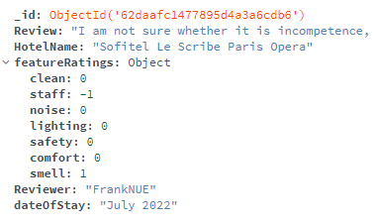
Generating Output Based on User Selection
Finally to tie everything together a user would be asked to complete a simple survey once they begin their hotel search.
What 3 things are most important to you in a hotel?
The user would select one of the classified keywords and the filter would sort hotels first by overall ranking, then by keyword ranking.
E.g. A hotel with 4 stars and a cleanliness rating of 8 would be placed higher on the list than a hotel with 4 stars and a cleanliness rating of 6.
Notes:
Garrett - It took us and the computer a lot of time to scrape, train, and format the data, but now we have it all neatly stored in a database and ready to be put to use. Moving forward we would expect the user to either select filter options based on our keywords or answer a survey about what features are most important to them. Then that input will be used to display the hotels based on both overall ranking and keyword ranking. So for example A hotel with 4 stars and a cleanliness rating of 8 would be placed higher on the list than a hotel with 4 stars and a cleanliness rating of 6.

Slide 16
Conclusion
Time taken to index hotels based on keywords is largely reduced by storing these values in a database.
Travel websites now have an extra feature to further cater their results to customers
Scalability comes naturally
Further improvements can be made
Data analytics to see which class of traveler prefers which features
Personalized dashboards can be marketed to hotels to help them map out where they can improve their experience
Notes:
Garrett - Using sentiment analysis and a mongo database we have created a data edge for travel websites to further customize their experience to their individual user preferences.
As we have previously mentioned, running the scraping and analysis takes roughly 3 hours to classify a subset of the reviews for 300 hotels. This obviously would not be scalable if we were expected to run this analysis every time a user made a search. By utilising a database we have made this classification scalable to a real world application and feasible for a production environment. The addition of a database allows for storage of classifications after ML processing. It also leaves things open for further improvements.
Thank you everybody for your time, are their any questions

